Slide 1





WORKSHOP ON ATOMISTIC CALCULATIONS
IN MATERIALS SCIENCE
Prof. Vladimir Srdić
Prof. Ivano Castelli
Prof. Dejan Zagorac
Doc. Stevan Armaković
15th ECerS Conference for Young Scientists in Ceramics

Slide 2
Agenda
14.45 – 15.05 h, Invited lecture
Stevan Armaković
Introducing fundamental concepts of atomistic calculations with tools of atomistica.online – online molecular modeling platform
15:05 – 15:45, Plenary lecture
Ivano E. Castelli
Computational workflows for an accelerated design of novel materials and interfaces
16:00 – 16.20, Invited lecture
Dejan Zagorac
Advanced ceramic materials: bridging the gap between theory and experiment
16:20 – 17:10, Practical part
Stevan Armaković
Hands-on molecular modeling with atomistica.online

Slide 3
Introducing fundamental concepts of atomistic calculations with tools of atomistica.online – online molecular modeling platform
University of Novi Sad
Faculty of Sciences
Department of Physics
Dr. Stevan Armaković
Assistant Professor
https://armakovic.com
https://atomistica.online
https://aidasco.org
15th ECerS Conference for Young Scientists in Ceramics

Slide 4




Slide 5
Turtle communicators
predecessors of mobile phones
Don’t forget, we are talking about 1987

Slide 6

My phone
Huawei P30 Lite
It has enough computing power to run semiempirical calculations!
Nowadays, everything goes online
Actually, an access to internet is enough to do research on molecules

Slide 7


PLATFORM FOR COMPUTATIONAL MODELING OF MATERIALS v2.0
Great for teaching,
Great for research,
but…

Slide 8
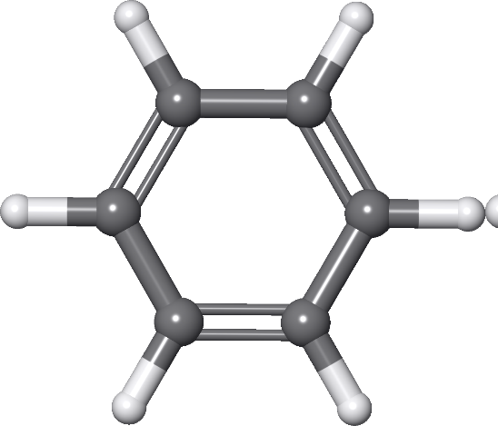

PART 1
MATERIALS MODELING
Branch of science that predicts selected properties starting from a structure
Properties
Materials modeling
&
Atomistic calculations
ATOMISTIC CALCULATIONS
Calculations that incorporate atomic-level information to provide macroscopic properties
Properties

Slide 9
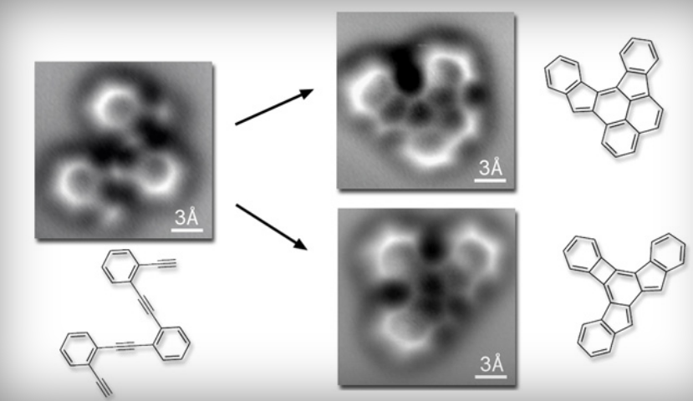
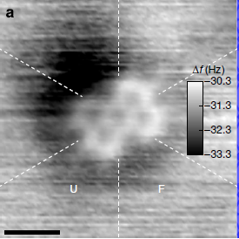
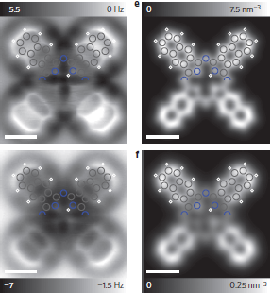
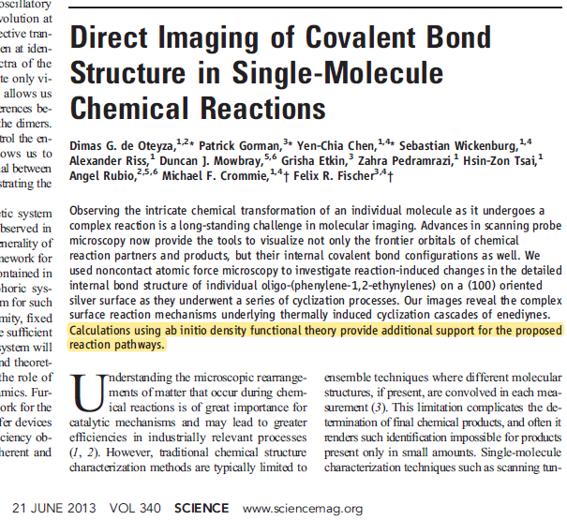
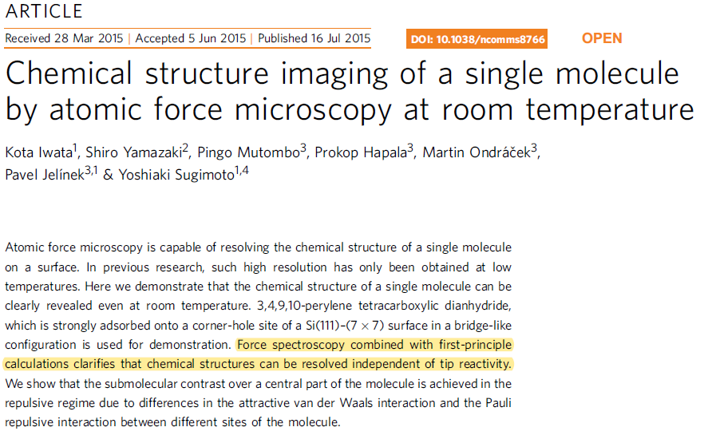
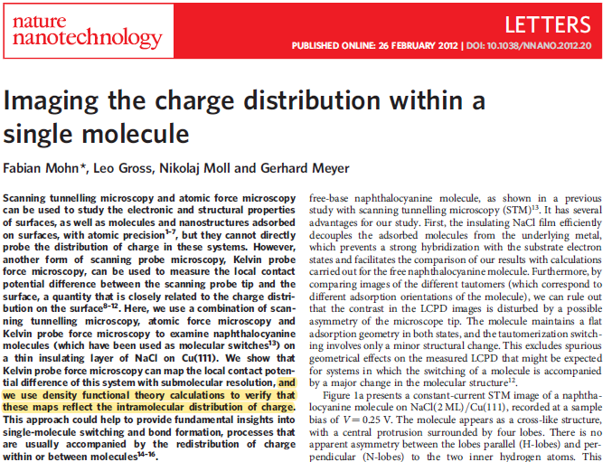
Atomistic calculations are everywhere…
Science 340 (2013) 1434
Nature Communications 6 (2015) 7766
Nature Nanotechnology 6 (2015) 7766
ab initio calculations
first principles calculations
DFT calculations

Slide 10
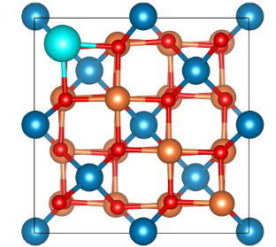
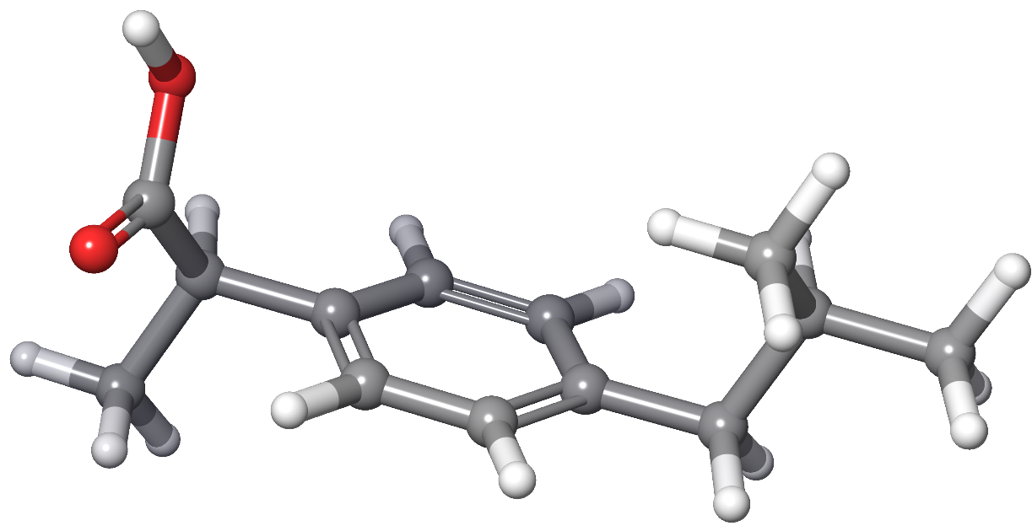
Materials
Molecules
Periodic structures

Slide 11




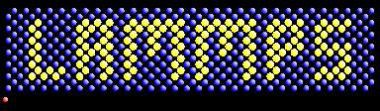


Free for academics
MOPAC®

Slide 12
What can be obtained via atomistic calculations?
Structural properties
Bond lengths
Crystal structure
Charge distribution
Electrostatic potential maps
Average local ionization energies
Spectroscopy
IR
NMR
Conductivity
Interactions
Lattice parameter
Symmetry
Dipole moments
UV/Vis
Reorganization energies
Charge transfer rates
Charge mobility
Binding energies
Binding characterization
Electron density difference
Phonons
Band structure
Band gap
Binding preference
Energy decomposition
Raman
Cell volume
Charge transfer
You name it, atomistic calculations can help you at least a little bit

Slide 13
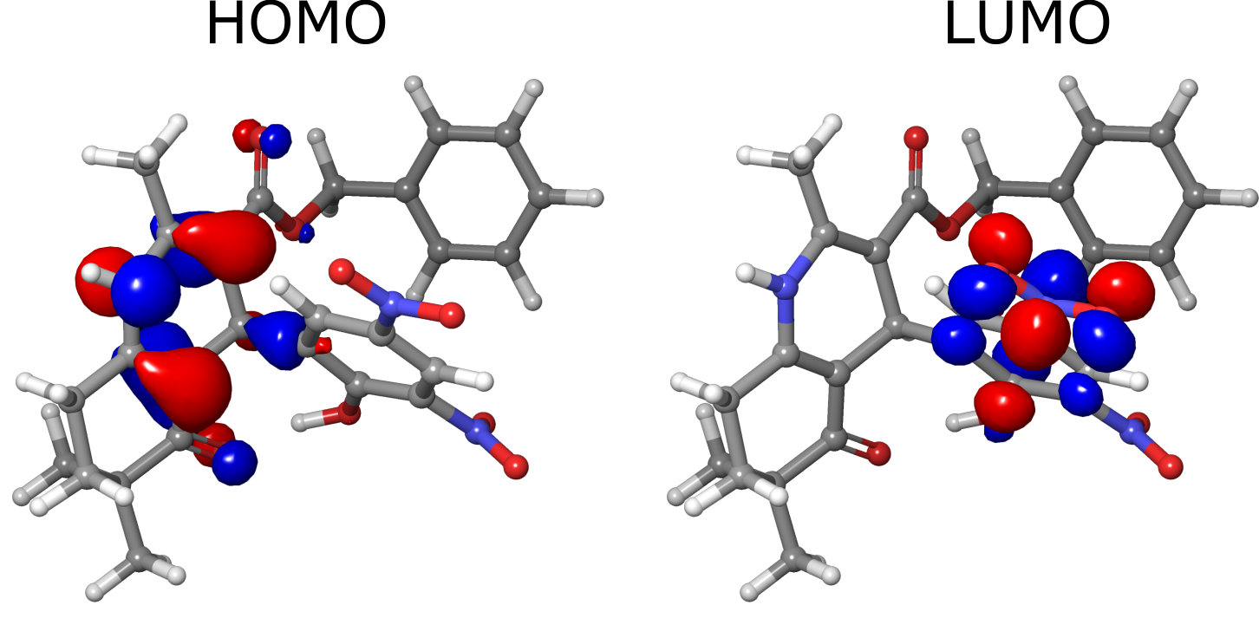
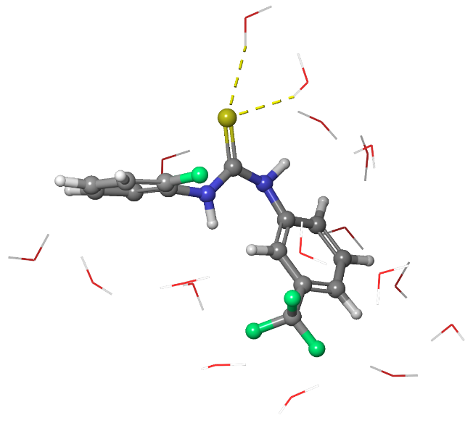
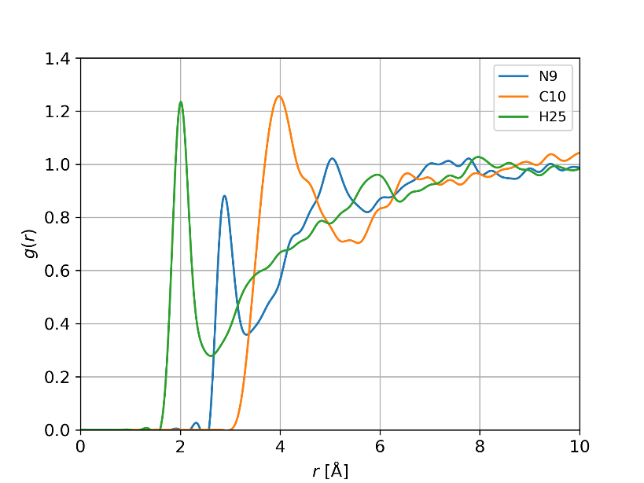
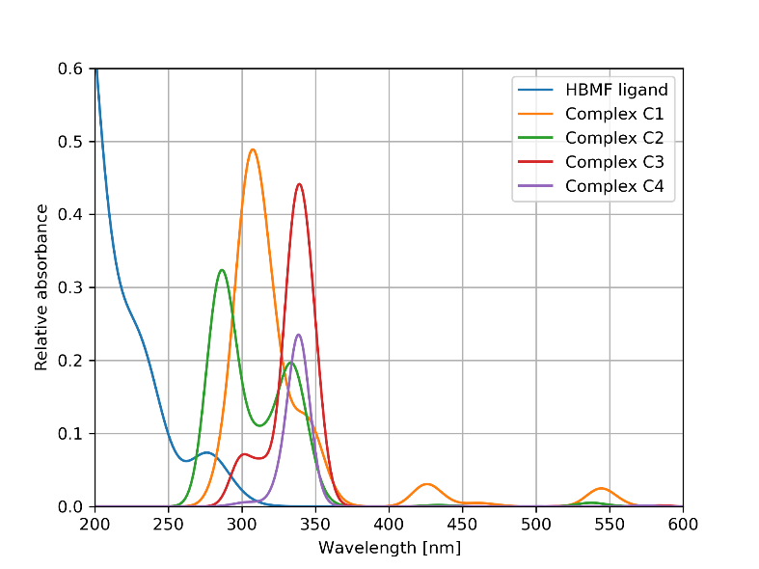
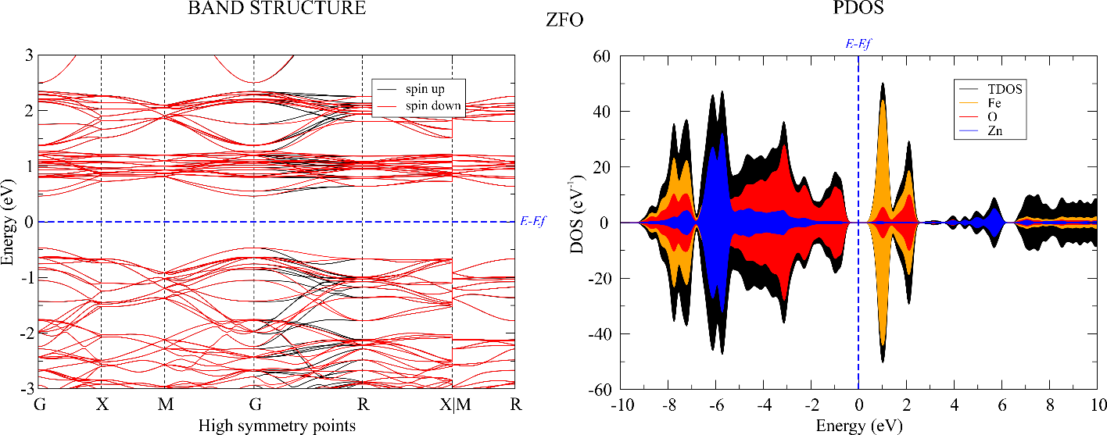
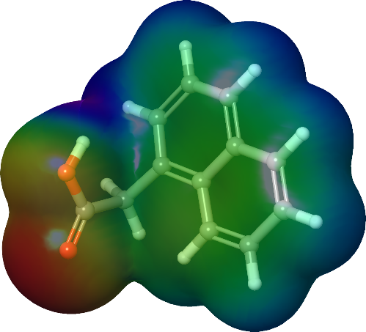
Experience so far

Slide 14

Basic workflow in computational materials science
STEP 1
STEP 2
STEP 3
Code for
atomistic calculations
Input
Output
GREAT, LETS GO, WHAT ARE WE WAITING FOR

Slide 15
PART 2
Single point energy calculations
Geometrical optimizations
Fundamental concepts
Vibrational frequencies
Output processing

Slide 16
Single point energy calculations
Single-point energy (SPE) calculation provides the total energy of a molecule or periodic structure at a specific geometric arrangement of its atoms geometry
Quantum mechanics
Molecular Mechanics
Wave function based
Density functional based
Force fields
Semiempirical methods
Speed
Accuracy

Slide 17
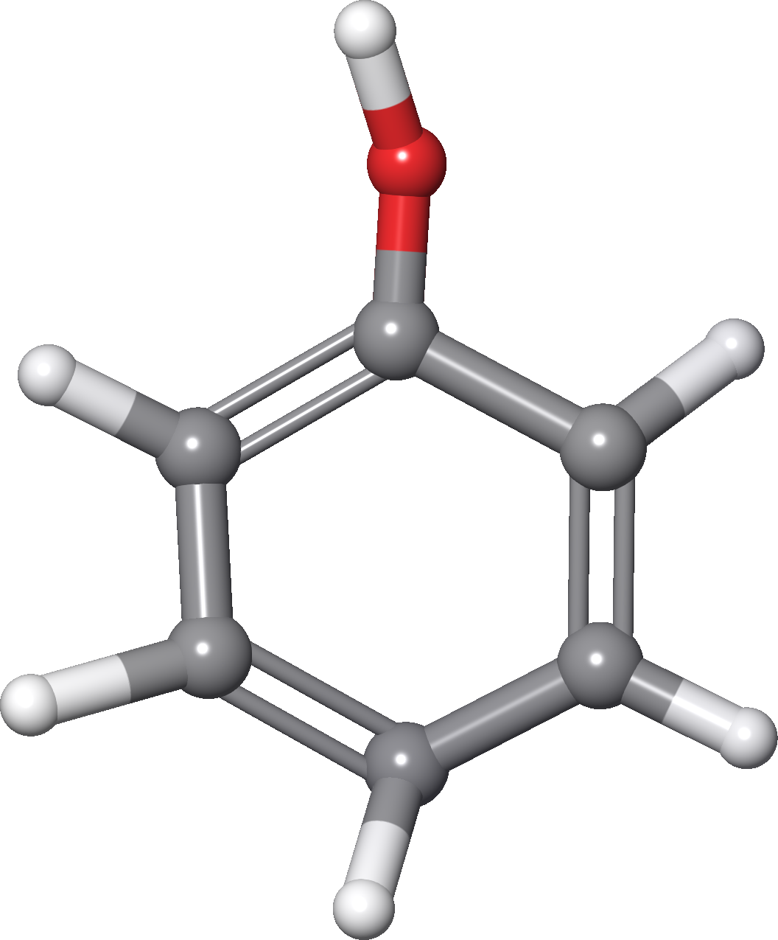
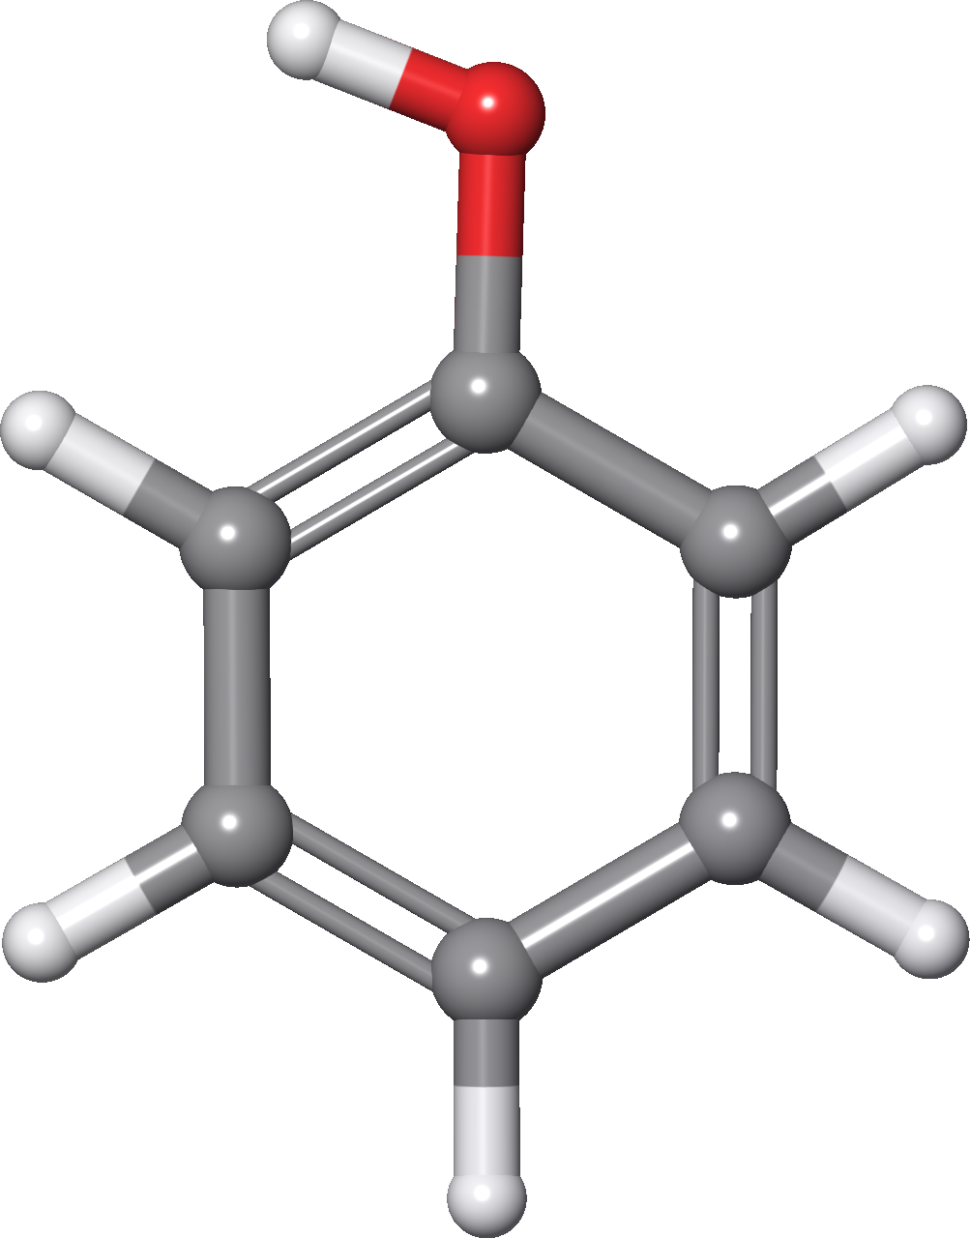



Geometrical optimizations
Geometrical optimization (relaxation) is the process by which the geometry of a molecule is adjusted to find a structure with the lowest possible energy
relaxation
$$E_{1}>E_{2}$$
$$E_{1}$$
$$E_{2}$$

Slide 18
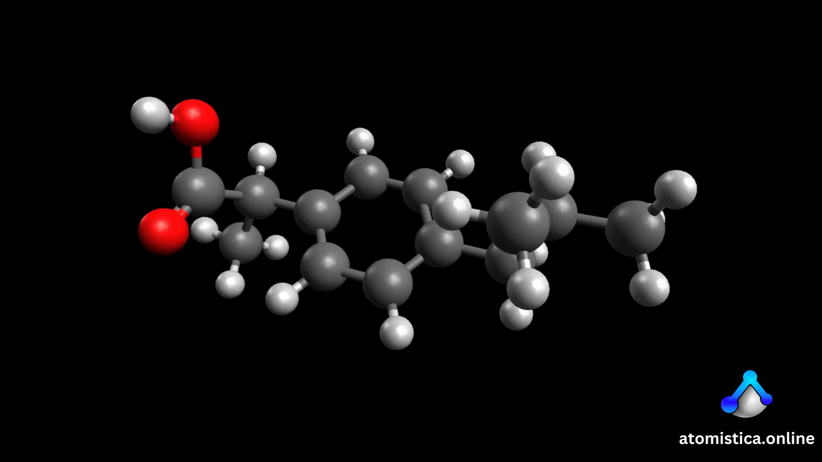
Vibrational frequencies
Atoms within a molecule oscillate about their equilibrium positions. The rate at which these atoms vibrate is described by vibrational frequencies.
Ground states:
only positive frequencies
Transition states:
have one imaginary frequency

Slide 19
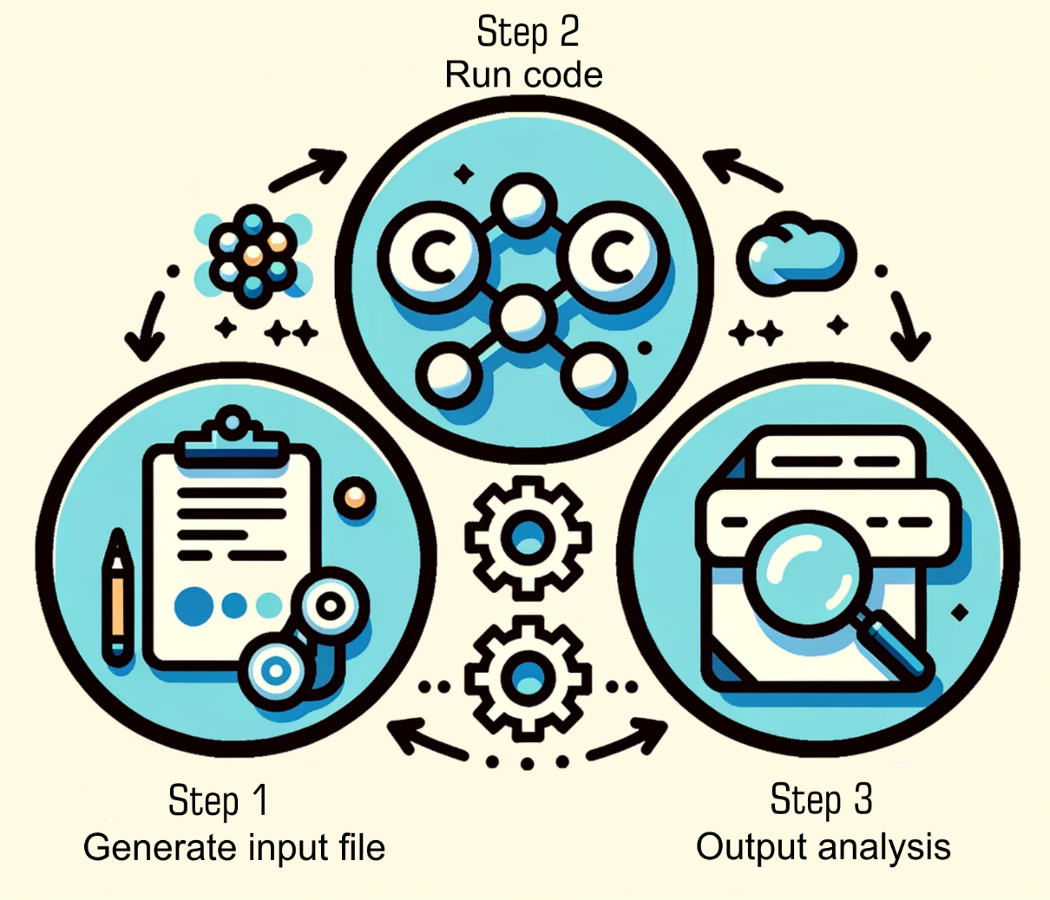
Output analysis & Post-processing
The raw results of calculations encapsulated in .out files, can be processed further with specialized tools.
Workflow
Options for analysis:
Directly read values
Use other post-processing tools

Slide 20

Practical example
Output
…
----------------------------
! ITERATION 4 !
----------------------------
Total Energy : -40.451208803483 Eh
Energy Change : -0.006264044762 Eh
MAX-DP : 0.006770598536
RMS-DP : 0.000717374642
Actual Damping : 0.0000
Actual Level Shift : 0.2500 Eh
Int. Num. El. : 10.00000000 (UP= 5.00000000 DN= 5.00000000)
Exchange : -5.18223043
Correlation : -0.35048235
DIIS-Error : 0.014865658102
DIIS coefficients:
0.19185 -0.11953 0.92768
==>> SHARK/AuxDens: NDens=1 Thresh = 2.500000e-11 TCut= 2.500000e-12 Lmax=2 LmaxAux=4
-> Making Hermite density - ok 0.001 sec
-> Making Aux-basis density - (lmax=2)
-> L=0 0: 0.000 sec done= 2310 (100.0%) skipped= 0
-> L=1 0: 0.000 sec done= 2310 (100.0%) skipped= 0
-> L=1 1: 0.000 sec done= 735 (100.0%) skipped= 0
-> L=2 0: 0.000 sec done= 385 (100.0%) skipped= 0
-> L=2 1: 0.000 sec done= 210 (100.0%) skipped= 0
-> L=2 2: 0.000 sec done= 35 (100.0%) skipped= 0
-> Aux basis density formed in 0.0 sec
-> Solving linear equations - ok ( 0.0 sec)
Auxbasis Hermite Density:
P|s> ... 0.000
P|p> ... 0.000
P|d> ... 0.000
P|f> ... 0.000
P|g> ... 0.000
…
Input file for ORCA code
!Opt Freq RKS B3LYP def2-TZVP def2/J CPCM(Water) Normalprint Printbasis PrintMOs PAL8
* xyz 0 1
C 0.00000 0.00000 0.00000
H -0.36330 1.02770 0.00000
H -0.36330 -0.51380 0.89000
H -0.36330 -0.51380 -0.89000
H 1.09000 0.00000 0.00000
*

Slide 21
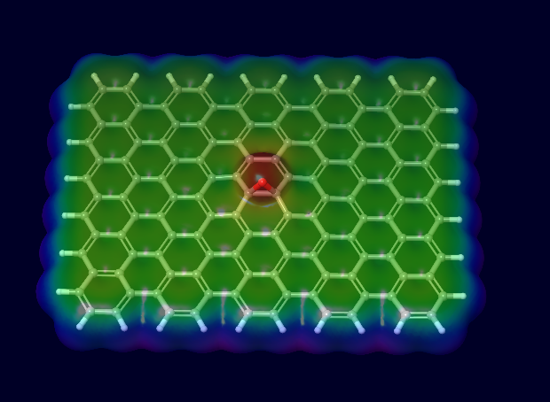

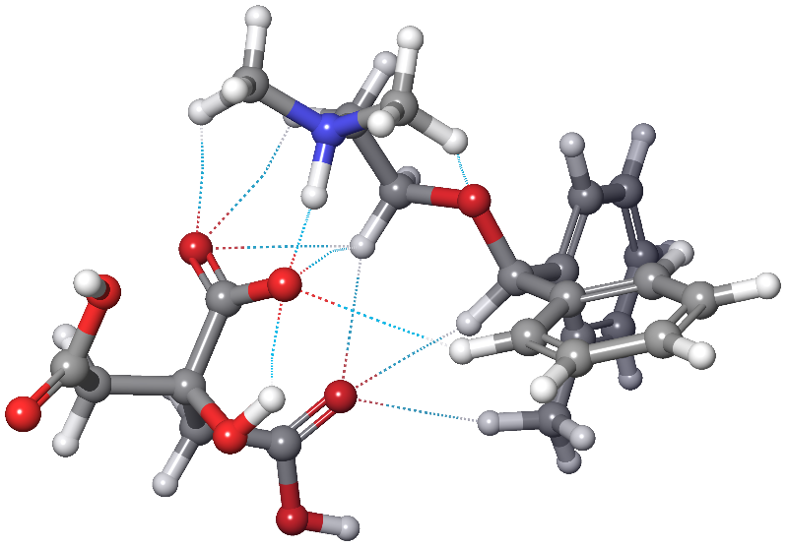
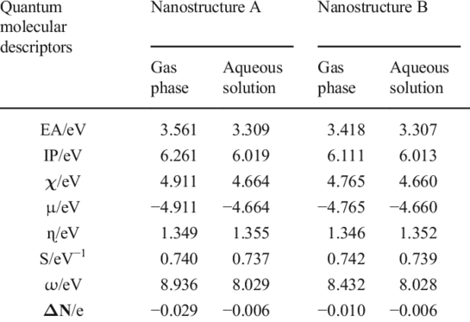
How to get something from output?
Output
…
----------------------------
! ITERATION 4 !
----------------------------
Total Energy : -40.451208803483 Eh
Energy Change : -0.006264044762 Eh
MAX-DP : 0.006770598536
RMS-DP : 0.000717374642
Actual Damping : 0.0000
Actual Level Shift : 0.2500 Eh
Int. Num. El. : 10.00000000 (UP= 5.00000000 DN= 5.00000000)
Exchange : -5.18223043
Correlation : -0.35048235
DIIS-Error : 0.014865658102
DIIS coefficients:
0.19185 -0.11953 0.92768
==>> SHARK/AuxDens: NDens=1 Thresh = 2.500000e-11 TCut= 2.500000e-12 Lmax=2 LmaxAux=4
-> Making Hermite density - ok 0.001 sec
-> Making Aux-basis density - (lmax=2)
-> L=0 0: 0.000 sec done= 2310 (100.0%) skipped= 0
-> L=1 0: 0.000 sec done= 2310 (100.0%) skipped= 0
-> L=1 1: 0.000 sec done= 735 (100.0%) skipped= 0
-> L=2 0: 0.000 sec done= 385 (100.0%) skipped= 0
-> L=2 1: 0.000 sec done= 210 (100.0%) skipped= 0
-> L=2 2: 0.000 sec done= 35 (100.0%) skipped= 0
-> Aux basis density formed in 0.0 sec
-> Solving linear equations - ok ( 0.0 sec)
Auxbasis Hermite Density:
P|s> ... 0.000
P|p> ... 0.000
P|d> ... 0.000
P|f> ... 0.000
P|g> ... 0.000
…
Input file for ORCA code
!Opt Freq RKS B3LYP def2-TZVP def2/J CPCM(Water) Normalprint Printbasis PrintMOs PAL8
* xyz 0 1
C 0.00000 0.00000 0.00000
H -0.36330 1.02770 0.00000
H -0.36330 -0.51380 0.89000
H -0.36330 -0.51380 -0.89000
H 1.09000 0.00000 0.00000
*

Slide 22
Free for academics
MOPAC®

Slide 23





MOPAC®
+
=
+ Home made tools

Slide 24
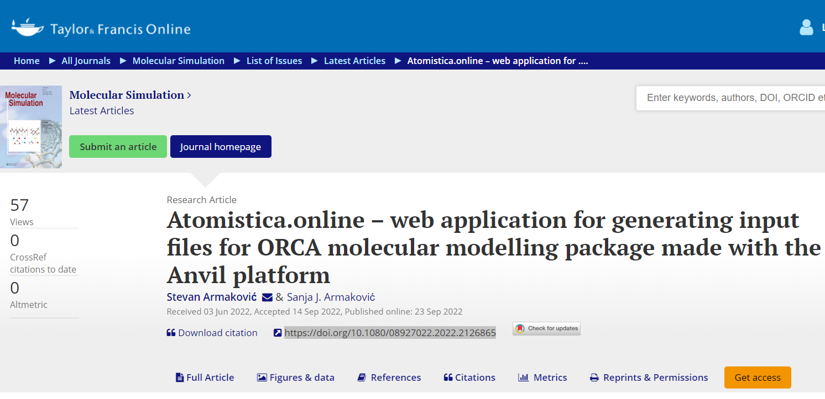
About atomistica.online
Presented in a paper published in “Molecular Simulation” journal
Initially conceived “just” as an online input generator for ORCA program.
Intended for teaching molecular modeling and for beginners in this field.
Developed using python and the Anvil platform.
Presented in a paper published in “Molecular Simulation” journal
https://atomistica.online

Slide 25
Comments & Questions session
Thank you for your attention
www.armakovic.com

